Slide 1
BOSTON HOUSE PRICES
Advanced Regression Techniques

Slide 2
Title and Content Layout
Objective:
Develop a machine learning model to predict house prices using the Boston Housing dataset.
Phases:
Data Collection and Preparation
Exploratory Data Analysis (EDA)
Feature Engineering
Model Training and Evaluation
Model Interpretation and Reporting

Slide 3
Data Collection and Preparation
Dataset from Kaggle: Boston Houseprice Data
Loaded into Pandas DataFrame for analysis.
Inspected for missing values and anomalies.
Dataset was clean and in the correct format, no additional cleaning necessary.

Slide 4
Exploratory Data Analysis (EDA)
Distribution:
MEDV values roughly normally distributed but slightly skewed to the right.
Key Correlations:
RM (Rooms per dwelling): Strong positive correlation with house prices.
LSTAT (Lower status population percentage): Significant negative correlation with house prices.
PTRATIO (Pupil-teacher ratio): Negative correlation with house prices.
Visualizations: Scatter plots, histograms, and box plots used to illustrate relationships.

Slide 5
Model Training and Evaluation
Algorithms:
Linear Regression
Decision Tree
Random Forest
Gradient Boosting
Metrics: RMSE, MAE, R²
Best Performing Model: Random Forest Regressor
RMSE: 2.901809
MAE: 2.204227
R²: 0.614449
Competitive Model: Gradient Boosting
RMSE: 2.666115
MAE: 2.091347
R²: 0.674537

Slide 6
Model Interpretation and Reporting
Important Features:
RM (Rooms per dwelling)
LSTAT (Lower status population percentage)
PTRATIO (Pupil-teacher ratio)
CRIM (Crime rate)
TAX (Property tax rate)
Recommendations
Explore additional feature engineering techniques.
Try advanced algorithms like XGBoost or Neural Networks.
Apply regularization techniques like Lasso or Ridge Regression to handle multicollinearity.

Slide 7
Model Performance Summary
Model Performance Summary
Model | RMSE | MAE | R²
Linear Regression | 2.526514 | 2.064111 | 0.707728
Decision Tree | 3.149675 | 2.622727 | 0.545770
Random Forest | 2.901809 | 2.204227 | 0.614449
Gradient Boosting | 2.666115 | 2.091347 | 0.674537

Slide 8
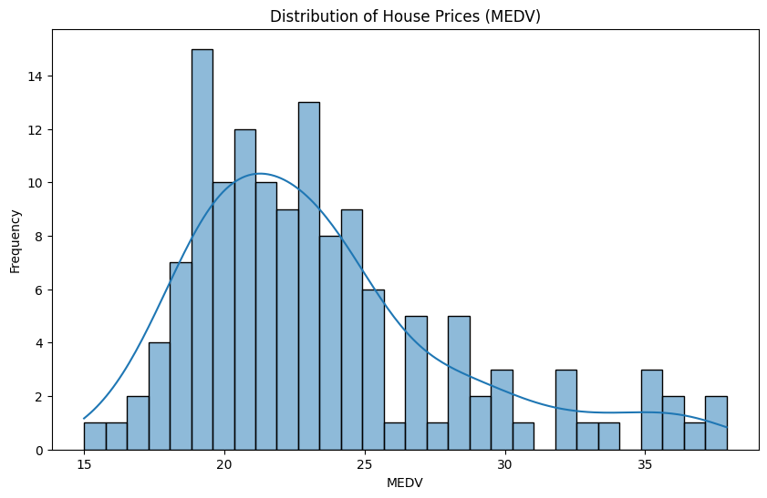
Distribution of House Prices

